Slide 1



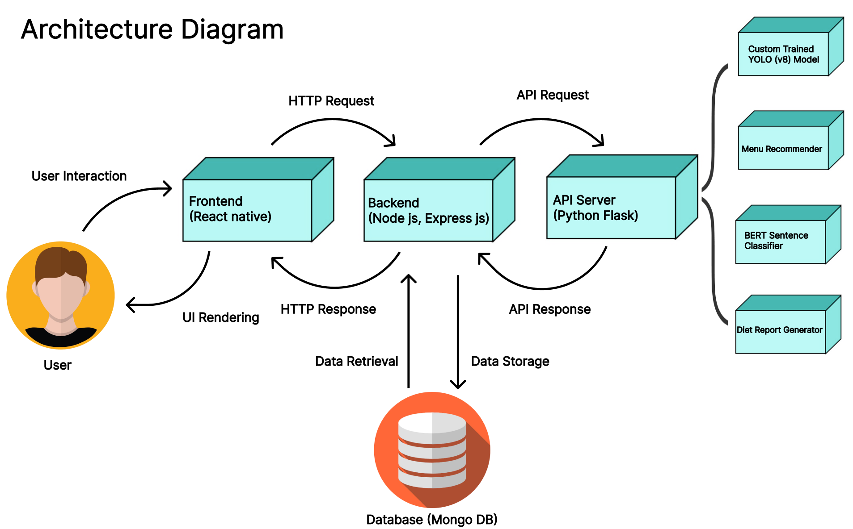
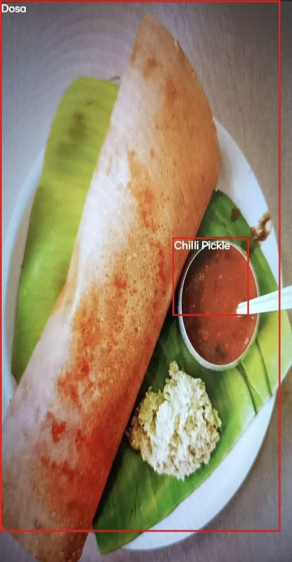
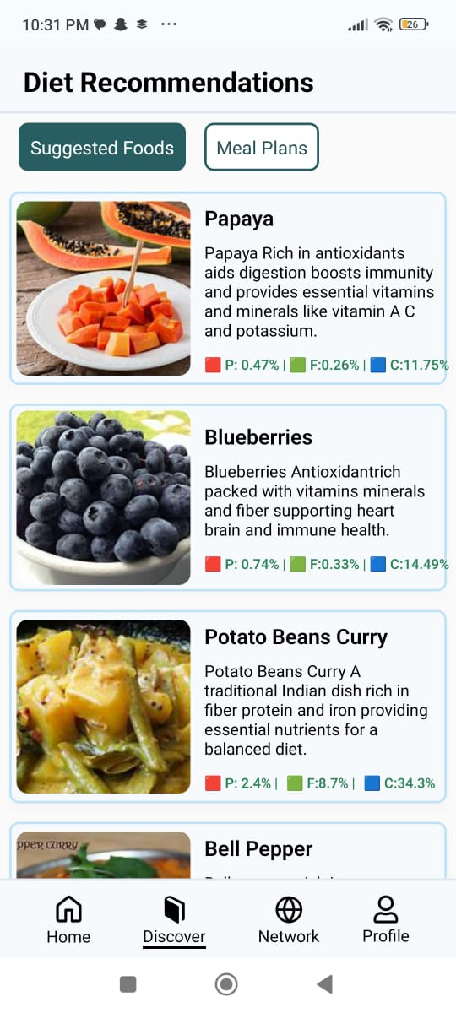
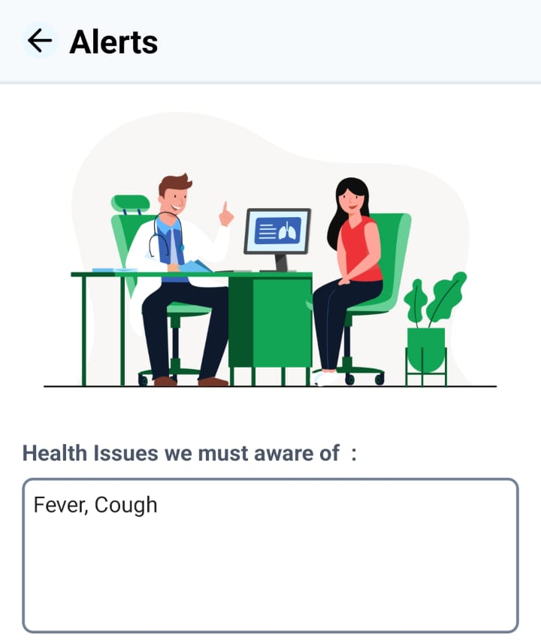
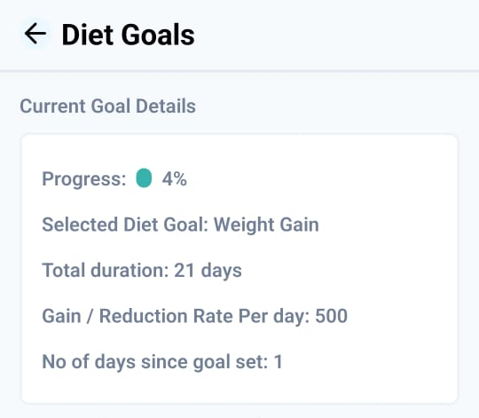
A Deep Learning-Powered Dietary Management and Food Analysis Application
DAPCom-2024
Authors: Shaik Esub , Pathan Sattar Khan, Prathipati Sandeep, Appala Sai Srija Guide: Dr. V. Muralidhar
Dept. of CSE (AI & ML), Vasireddy Venkatadri Institute of Technology (VVIT), Nambur, Peda Kakani, Guntur, Andhra Pradesh (522508)
introduction
methodology
results
The main concept is to develop an innovative and comprehensive app that aims to revolutionize dietary management through the use of Deep Learning and Natural Language Processing (NLP) techniques. The app utilizes a BERT Sentence Classifier and a custom-trained Deep Learning Model for food detection, enabling users to accurately record and monitor their food intake in a user-friendly manner. The app's diverse database provides users with detailed nutritional information, including calories, carbohydrates, fats, and proteins. It also incorporates a variety of charts and graphs to display variations in nutritional information for each food intake and perform analytics over the food data.
Additionally, the app offers personalized dietary recommendations, Food Allergen Alerts, Report Generation, and goal setting for weight gain and weight loss, empowering users to make informed choices about their dietary habits and health.
objectives
Food Logging using Picture
Diet Suggestions
Utilize Deep Learning and NLP techniques, including a BERT Sentence Classifier and custom-trained models, for accurate food detection and user-friendly recording of food intake. Provide a diverse database with detailed nutritional information, interactive charts, and graphs to enhance user awareness of dietary habits.
Enable personalized dietary recommendations, Food Allergen Alerts, and goal setting for weight gain or loss.
Generate comprehensive reports to empower users with actionable insights, fostering informed choices for improved health and well-being.
Goal Setting and Tracking:
The Unique Physical Characteristics serve as crucial parameters for establishing and monitoring Diet Goals.
The Harris-Benedict equation is a method to estimate the Basal Metabolic Rate (BMR), indicative of the calories required by the body at rest. The formulas for males and females are as follows:
For males:
BMR = 88.362 + (13.397 × weight) + (4.799 × height) - (5.677 × age)
For females:
BMR = 447.593 + (9.247 × weight) + (3.098 × height) - (4.330 × age)
The Total Calories are computed by multiplying BMR with the Activity Factors (Activity levels vary, depending on activity levels such as Sedentary, Lightly Active, Moderately Active, Very Active, and Extremely Active)
Applying specific criteria, such as a 500-calorie daily deficit, aiming for a 1-pound per week loss, and considering a sedentary activity level, we can effectively set and monitor user goals for weight loss, weight gain, etc.
Intake History, Allergen Alerts & Diet Reports:
Our application includes an Intake History feature seamlessly integrated with MongoDB, a versatile NoSQL database containing user-generated dietary information. This feature allows users to monitor and track their food intake over time, providing valuable insights into their dietary habits and patterns.
Allergen Alerts are delivered to users through Google’s Gemini API. When logging food, the system checks against the user's health issues to notify whether a particular food item is recommended or not.
Diet Reports, which include an analysis of intake history, are scheduled to be sent to users via email every week, month, and year. Additionally, users have the option to generate reports within the application itself.
METHODOLOGY
Tracking of Diet Goals
Food Logging using Image and Manual Entry:
For image recognition, we trained the YOLOv8 pre-trained model with our custom food image data for object detection. This model accurately identifies food items in images captured by the user's smartphone camera.
By the utilization of a custom-trained BERT model for sentence classification, the manual entry of food can be done using either the actual name of the food or a description. This enables users to input meal details manually through various food descriptions in terms of visibility, taste, etc. ensuring an efficient logging of dietary intake.
Personalized Dietary Recommendations:
The system calculates the users BMI and categorize users as Underweight, Normal, Overweight, or Obese.
Recommendations depend on BMI: Underweight suggests foods with adequate protein/carbs or higher calorie content; Normal Weight considers balance in protein/carbs, low fat, or sufficient calories; Overweight/Obese suggests foods with sufficient protein, low carbs/fat, or low calories.
Food Allergen Alerts
conclusion
Therefore, our application emerges not only as a sophisticated mobile application but as a holistic dietary companion. Its user-friendly interface, coupled with advanced technologies, empowers individuals to make informed choices about their dietary habits and overall well-being. As we continue this journey, the commitment to excellence, user satisfaction, and a healthier lifestyle remain at the core of our application’s mission.
REFERENCES
Calorie Calculator : https://www.nasm.org/resources/calorie-calculator
Revised-Harris–Benedict-Equation:https://www.ncbi.nlm.nih.gov/pmc/
articles/PMC9967803/
YOLOv8 Object Detection: https://medium.com/cord-tech/yolov8-for-object-detection-explained-practical-example-23920f77f66a

